Slide 1
Random Graphs – II
MA 653: Network Science
Instructor: Ashok Singh Sairam
ashok@iitg.ac.in

Slide 2
Giant Component: What about the remaining nodes?
The giant component of a random graph typically fills up a very large portion of the graph vertices but not 100% of them
Is there only 1 giant component?
How are the rest of the nodes connected?
If we can show that there can be only one giant component in a G(n,p) graph → all other components are non-giant (i.e., small components)
What is the average size of a small component?
Many small components
Show that the average size is constant with the size of the network

Slide 3
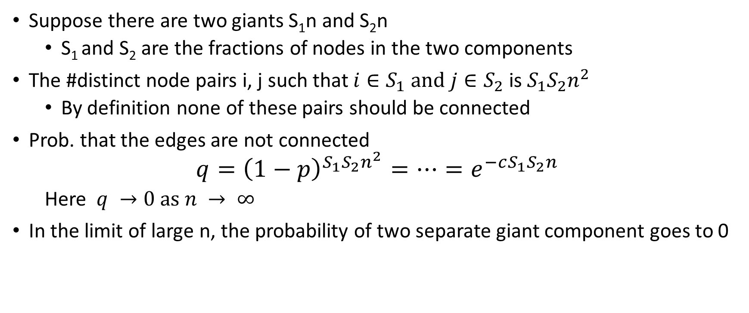
More than one giant component?
Suppose there are two giants S₁n and S₂n
S₁ and S₂ are the fractions of nodes in the two components
The #distinct node pairs i, j such that $i∈S_{1} and j∈S_{2}$ is $S_{1}S_{2}n^{2}$
By definition none of these pairs should be connected
Prob. that the edges are not connected
$$q={\left(1−p\right)}^{S_{1}S_{2}n^{2}}=…=e^{−cS_{1}S_{2}n}$$
Here $q →0 as n → ∞$
In the limit of large n, the probability of two separate giant component goes to 0

Slide 4
Small Component: average size
We have shown that there exists only one giant component
The remaining nodes are small components
Small component: components whose size grows slower than n
There must be many of them as n becomes large
What is the average size of a small component?
Show that a small component is a tree
Consider a node i in the small component (tree) with degree k
The component is a “connection” of k subgraphs
Compute the sum of these subgraphs

Slide 5
Small components are trees

Slide 6
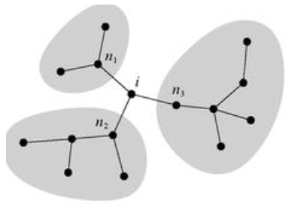
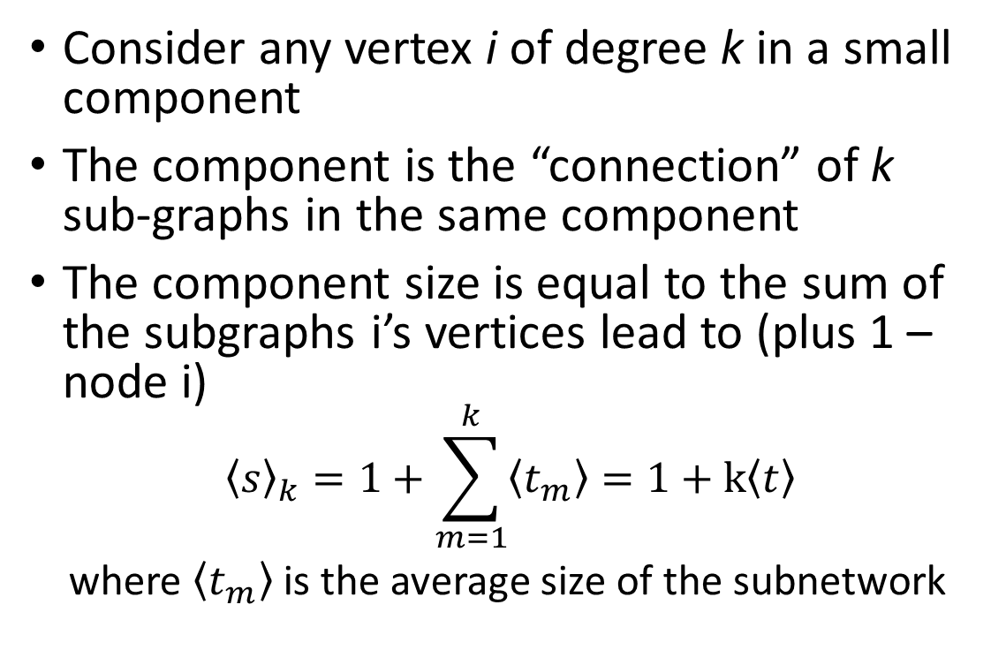
Size of a small component
Consider any vertex i of degree k in a small component
The component is the “connection” of k sub-graphs in the same component
The component size is equal to the sum of the subgraphs i’s vertices lead to (plus 1 – node i)
$${\left\langle s\right\rangle }_{k}=1+\sum_{m=1}^{k}{\left\langle t_{m}\right\rangle }=1+k\left\langle t\right\rangle$$
where $\left\langle t_{m}\right\rangle$ is the average size of the subnetwork

Slide 7
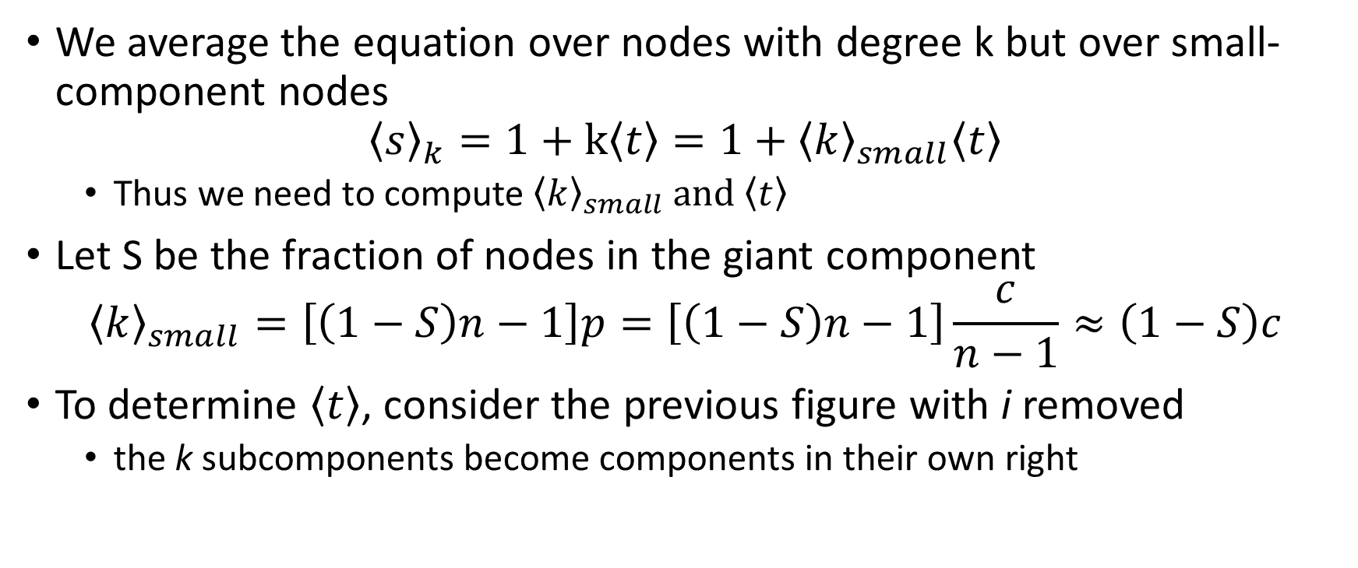
We average the equation over nodes with degree k but over small-component nodes
$${\left\langle s\right\rangle }_{k}=1+k\left\langle t\right\rangle =1+{\left\langle k\right\rangle }_{small}\left\langle t\right\rangle$$
Thus we need to compute ${\left\langle k\right\rangle }_{small} and \left\langle t\right\rangle$
Let S be the fraction of nodes in the giant component
$${\left\langle k\right\rangle }_{small}=\left[\left(1−S\right)n−1\right]p=\left[\left(1−S\right)n−1\right]\frac{c}{n−1}≈\left(1−S\right)c$$
To determine $\left\langle t\right\rangle$, consider the previous figure with i removed
the k subcomponents become components in their own right

Slide 8
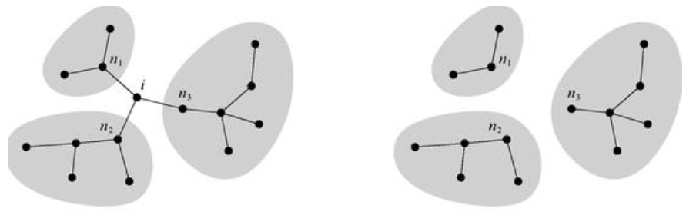

The neighbours n₁,n₂,.. are separate small components
The subcomponents are still a random graph with same edge probability p
The average size of the subcomponents = average size of any small component = s, $that is, \left\langle t\right\rangle =\left\langle s\right\rangle$

Slide 9
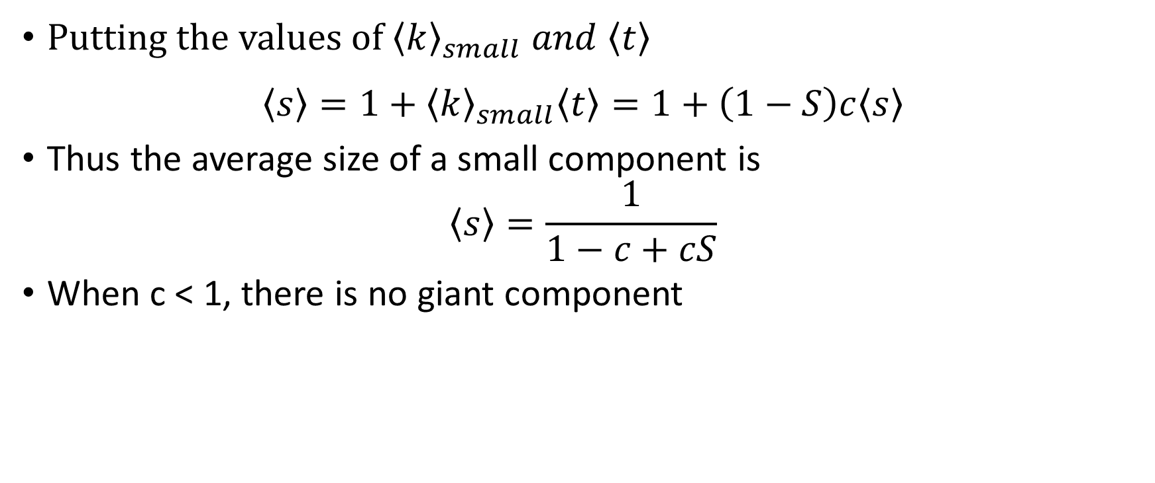
Putting the values of ${\left\langle k\right\rangle }_{small} and \left\langle t\right\rangle$
$$\left\langle s\right\rangle =1+{\left\langle k\right\rangle }_{small}\left\langle t\right\rangle =1+\left(1−S\right)c\left\langle s\right\rangle$$
Thus the average size of a small component is
$$\left\langle s\right\rangle =\frac{1}{1−c+cS}$$
When c < 1, there is no giant component

Slide 10
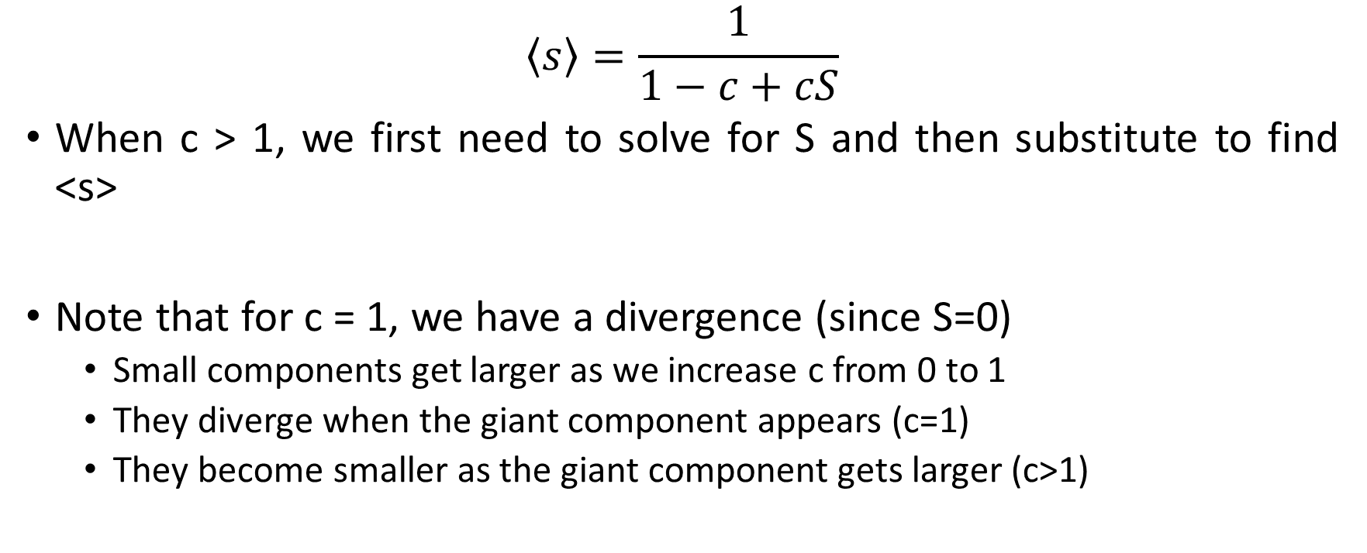
$$\left\langle s\right\rangle =\frac{1}{1−c+cS}$$
When c > 1, we first need to solve for S and then substitute to find <s>
Note that for c = 1, we have a divergence (since S=0)
Small components get larger as we increase c from 0 to 1
They diverge when the giant component appears (c=1)
They become smaller as the giant component gets larger (c>1)

Slide 11
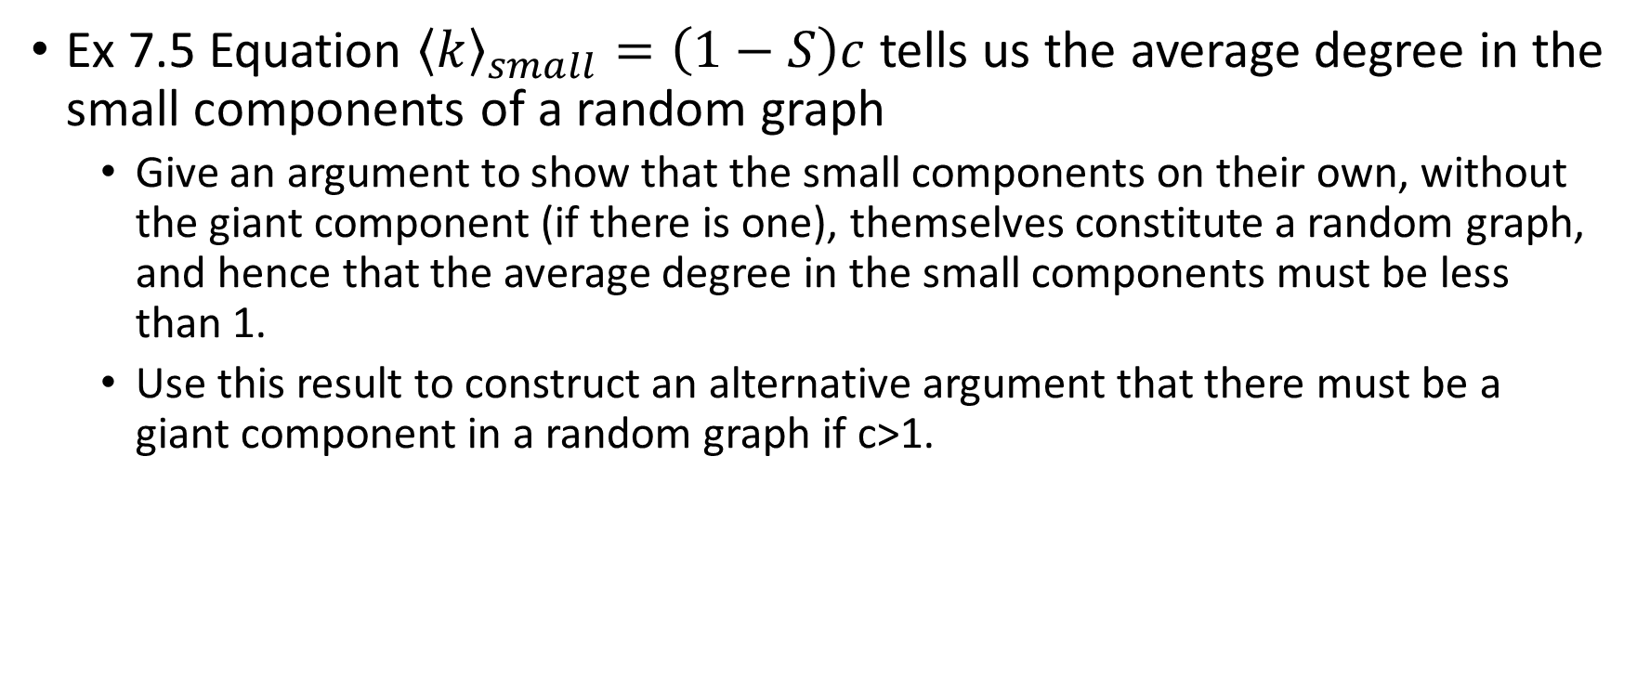
Exercise
Ex 7.5 Equation ${\left\langle k\right\rangle }_{small}=\left(1−S\right)c$ tells us the average degree in the small components of a random graph
Give an argument to show that the small components on their own, without the giant component (if there is one), themselves constitute a random graph, and hence that the average degree in the small components must be less than 1.
Use this result to construct an alternative argument that there must be a giant component in a random graph if c>1.

